Slide 1
SQL - Transactions

Slide 2
Agenda
What is a transaction?
When to use transactions
Transaction properties
Syntax of transaction
Transaction state

Slide 3

What is a transaction?
Transaction is all or none
Example of a transaction is the process of Fund Transfer

Slide 4
When to use transactions
When several operations must succeed or fail as a unit:
Change to one table requires that other tables be kept consistent
Modifying data in two or more databases concurrently

Slide 5
Transaction properties
A transaction is characterized by ACID properties:
Atomicity: Transactions are all or nothing
Consistency: Only valid data is saved
Isolation: Transaction don’t affect each other
Durability: Written data won't be lost

Slide 6
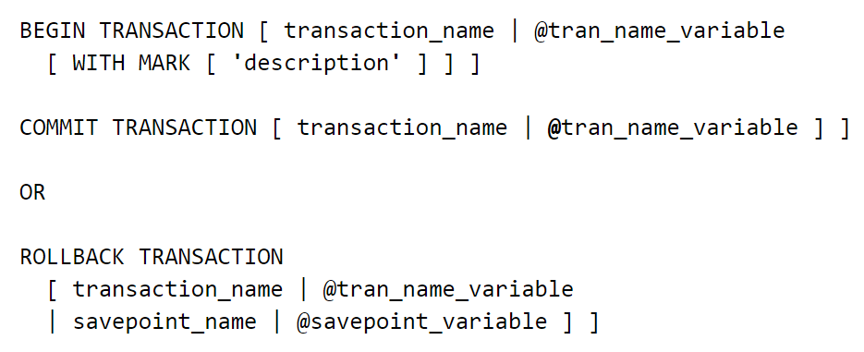
Syntax of transaction

Slide 7
Transaction State
A transaction must be in one of the following states:
Active
Partially committed
Failed
Aborted
Committed

Slide 8
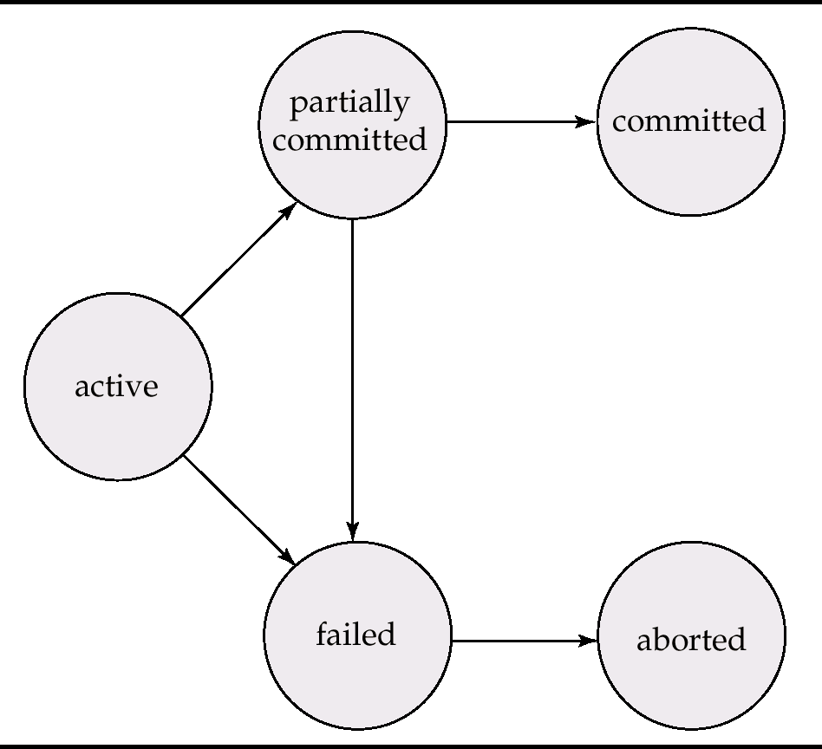
Transaction state

Slide 9
Summary

Slide 10

thank you for listening !

Slide 11
Transaction Control
Commands used to control transactions:
COMMIT
ROLLBACK
SAVEPOINT
SET TRANSACTION

Slide 12
Transaction Control
COMMIT: to save the changes.
COMMIT;
ROLLBACK: to rollback the changes.
ROLLBACK;

Slide 13
Transaction Control
SAVEPOINT: creates points to rollback.
SAVEPOINT SAVEPOINT_NAME;
ROLLBACK TO SAVEPOINT_NAME;
SET TRANSACTION: to initiate a transaction.
SET TRANSACTION [ READ WRITE | READ ONLY ];

